Slide 1
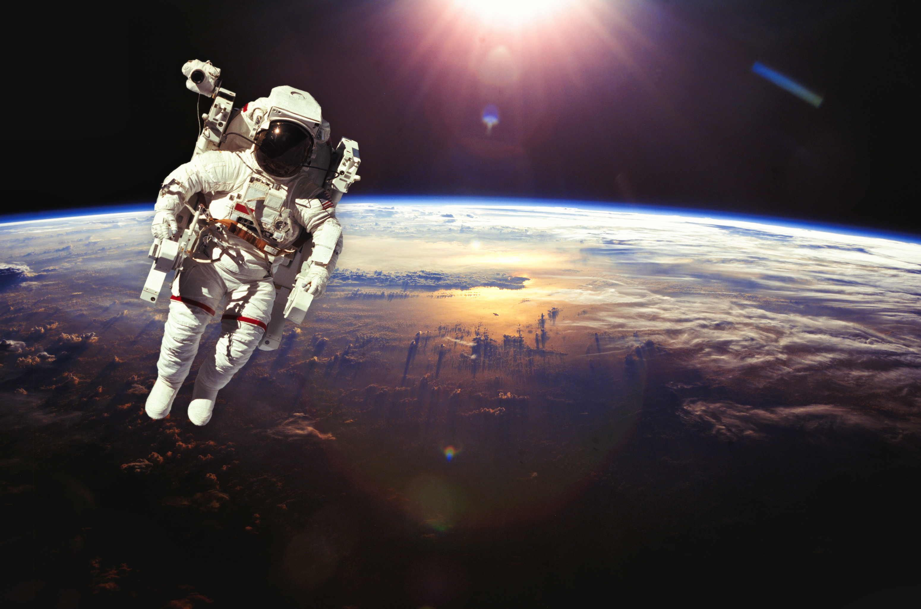

SATELLITE IMAGE BRIGHTNESS NORMALISER
Team: zerobit
problem 1 - satelite image brigtness normalizer
PAGE 01

Slide 2
What Problem Does It Solve?
Problem
• Satellite images come in different brightness & contrast levels.
• Makes training ML models hard.
• Competitions (like Xview2) want normalized input.
Solution
One tool that:
• Normalizes brightness
• Matches contrast
Works on folders or zip files
PAGE 02

Slide 3
How Does the App Work?
Workflow
UI
1. Select images or zip file
2. Choose global balancing mode (optional)
3. Click to process
4. Output saved neatly
• Dark themed with clean buttons
Background image with blur
• Uses customtkinter for
PAGE 03

Slide 4
Key Features
Feature
Description
Folder Select
Load multiple image
Global Balancing mode
Histogram Matching
Use average brightn
Syncs contrast acro: images
competition_output/
brightness Scaling
Auto corrects expos
CLAHE
ZIP Processing
Smart contrast per
region
Unzips, processes, cleans up
Output folders: output/ and
PAGE 04

Slide 5
What's Under the
Hood?
Technologies Used
• OpenCV: image processing
• customtkinter: modern GUl
• os, shutil: file operations
• zipfile: unzip on-the-fly
image Pipeline
1. Load image
2. Resize (consistent size)
3. Histogram match to base
4. Scale brightness to target
5. Apply CLAHE
6. Save to output
PAGE 05

Slide 6
What is Histogram Matching?
Makes one image look like another
Matches contrast and brightness distribution
Helps uniformity when dataset is messy
Example:
Image A (reference) Image B (adjusted to match A)
PAGE 06

Slide 7
CLAHE
What is it?
Contrast Limited Adaptive Histogram
Equalization
Why use it?
Regular contrast boost = too harsh
• CLAHE boosts per-tile contrast
• Preserves details in shadow/highlight areas
Looks natural, not overprocessed
PAGE 07

Slide 8
ModeDescription
🎯 Normal Mode
- Every image is adjusted to a fixed brightness level (e.g., 150)
- Great for general cleanup
- Each image treated individually
🌍 Global Balancing Mode (Competition Mode)
- App calculates the average brightness across all images
- All images are then scaled to match that average
- Ensures uniformity — ideal for competitions or model training
PAGE 08

Slide 9

Name / Role Responsibilities
You (Research Lead)
- Researched image normalization techniques 🧠
- Studied CLAHE, histogram matching, etc.
- Helped define the processing logic
Teammate 2 (Coder)
- Assembled the GUI using Python and customtkinter 💻
- Wrote core logic for image processing
- Handled competition mode, ZIP handling
Teammate 3 (Presenter/Writer)
- Created presentation slides & documentation 📊
- Helped structure the explanation
- Prepped for demo and Q&A
HOME
ABOUT
CONTENT
OTHERS
PAGE 09

Slide 10
7. References
• External libraries (e.g., OpenCV, NumPy, Pandas)
• Online tutorials (e.g., YouTube, Medium blogs)
Code inspirations (e.g., GitHub repos)
• APIs or datasets used
• Documentation from official sites
• Al tools or coding assistants (e.g., Chatgpt,deepseek)
• Courses or study material used
• Citation format used (APA, MLA, etc.)
PAGE 10

Slide 11

PAGE 04

